Slide 1
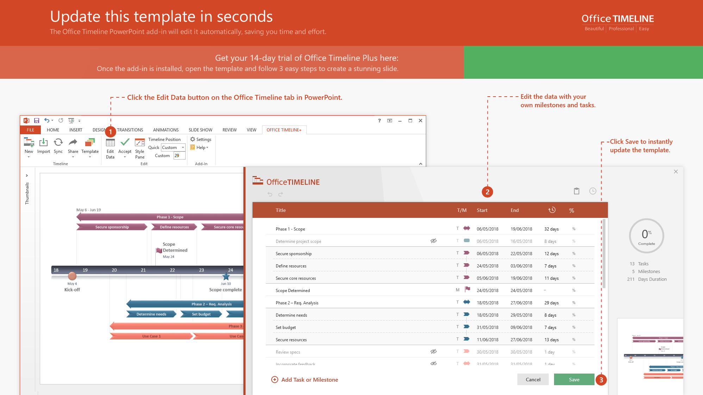
https://www.officetimeline.com/14-days-trial

Slide 2
Gantt Chart
9/20 - 10/8
Requirements
9/20 – 10/8
Tools
10/8 - 10/20
Initial Prototype
10/8 – 10/20
Testing Plan
10/20 – 10/31
Second version of prototype
10/31 – 11/25
Working Prototype
10/31 – 11/25
Code
11/25 - 11/28
Testing
34 days
11/28 - 12/4
Website Release
2020
September
October
November
December
2020
Today
09/20/2020
12/4/2020
Project Start
Project End

